Slide 1
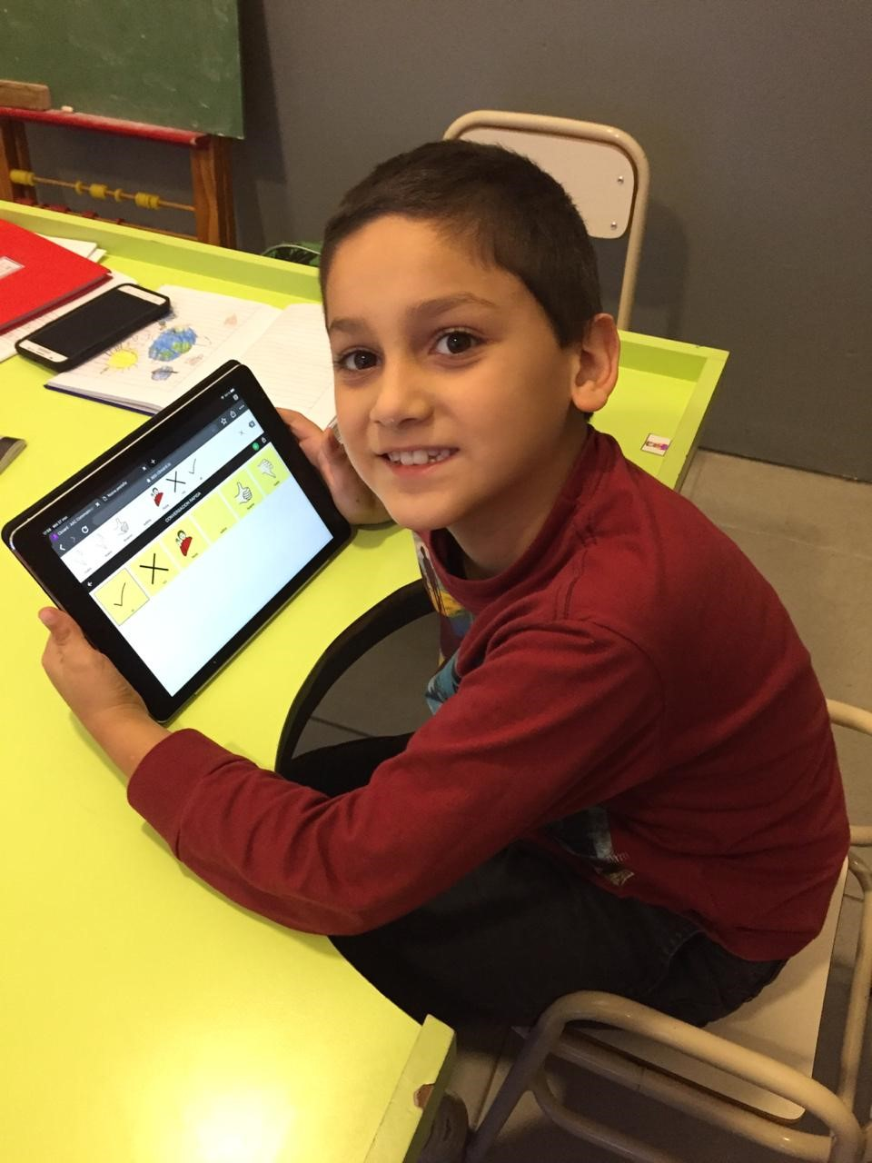
Building Boards 3
E.A. Draffan

Slide 2
Cboard ideas for the future

Slide 3
Building Boards
Petra Age 6 –Topic board building – 2 word phrases
https://bit.ly/2N98gwi larger fonts /export
Bubbles – printing as PDF for laminated board

Slide 4
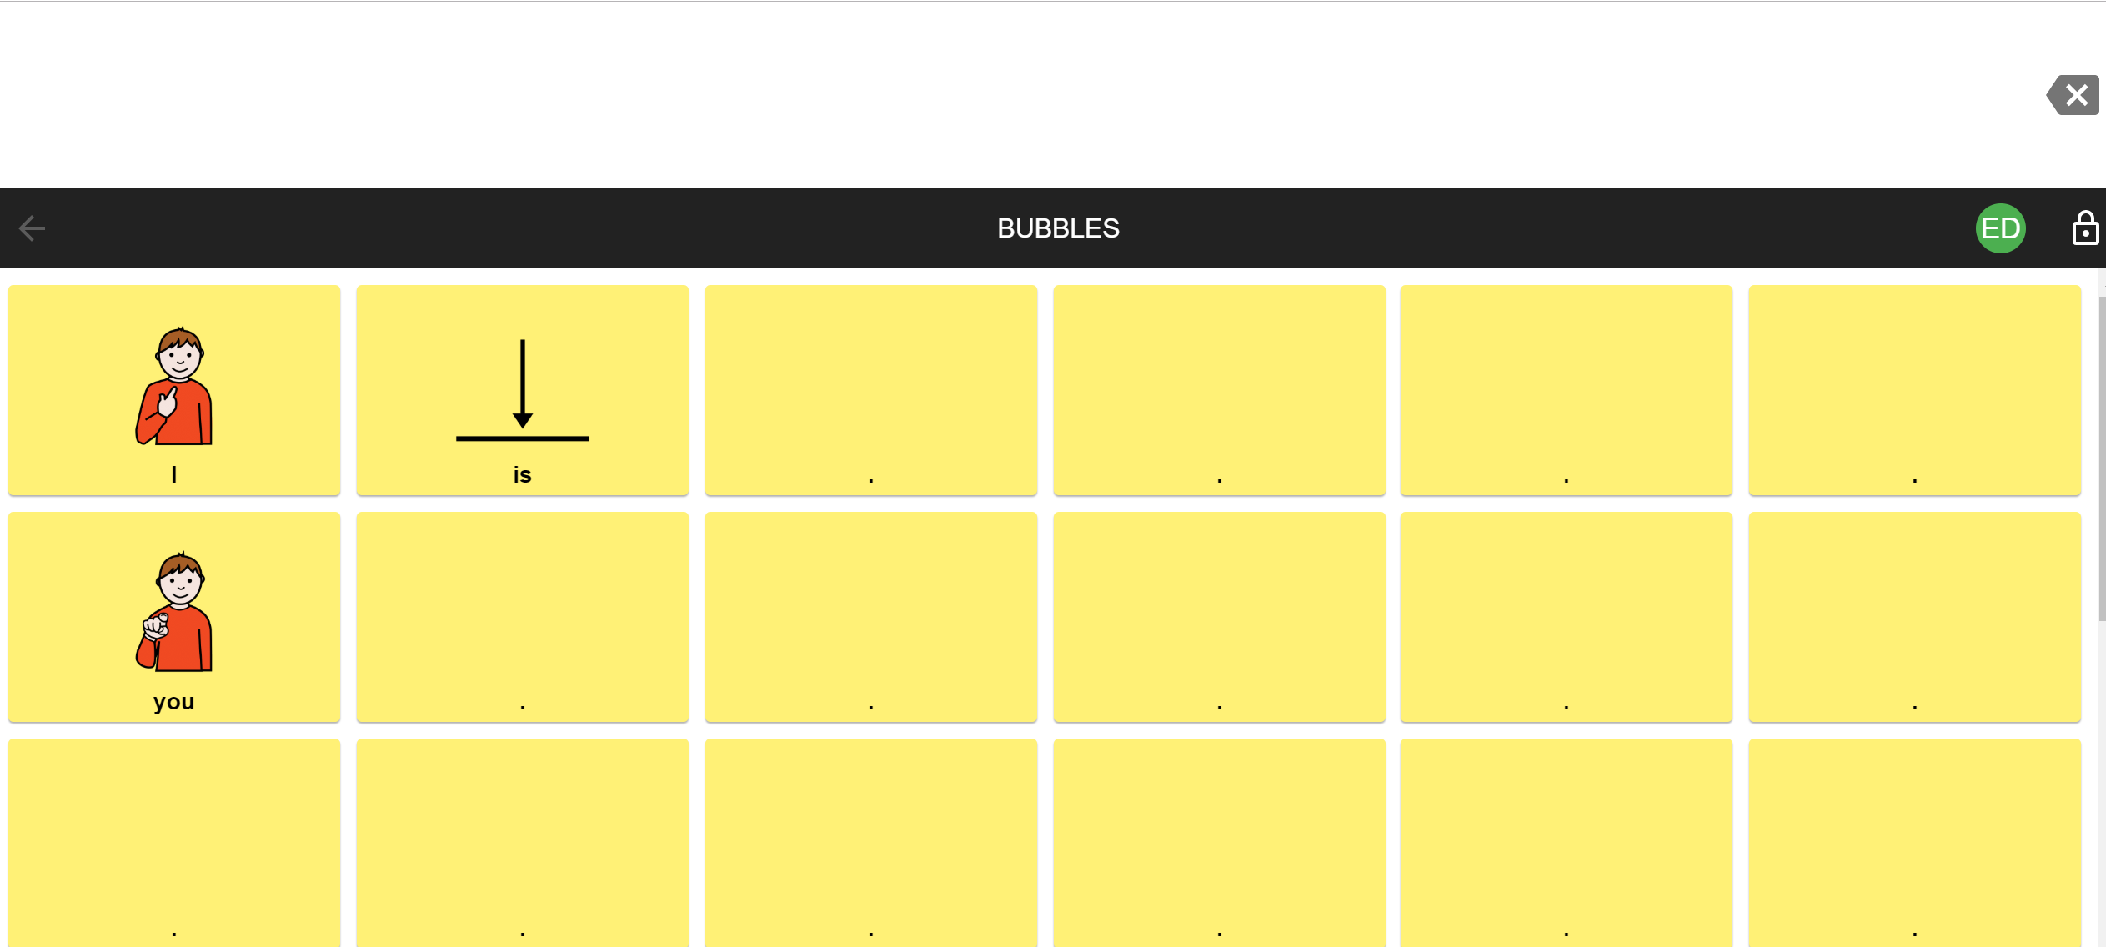
Bubbles – topic board
I | is | blow | not | where | bubbles
you | can | like | more | different | wand
he | catch | go | this | finished | David
she | pop | stop | that | on | Alex
it | want | look | now | good
yes |  |  |  |  | no

Slide 5
Progression
Frederick age four with Down’s Syndrome
Communication books
Progression to literacy skills
Upload a chart as an obf file… available from CoughDrop even if you are not registered

Slide 6
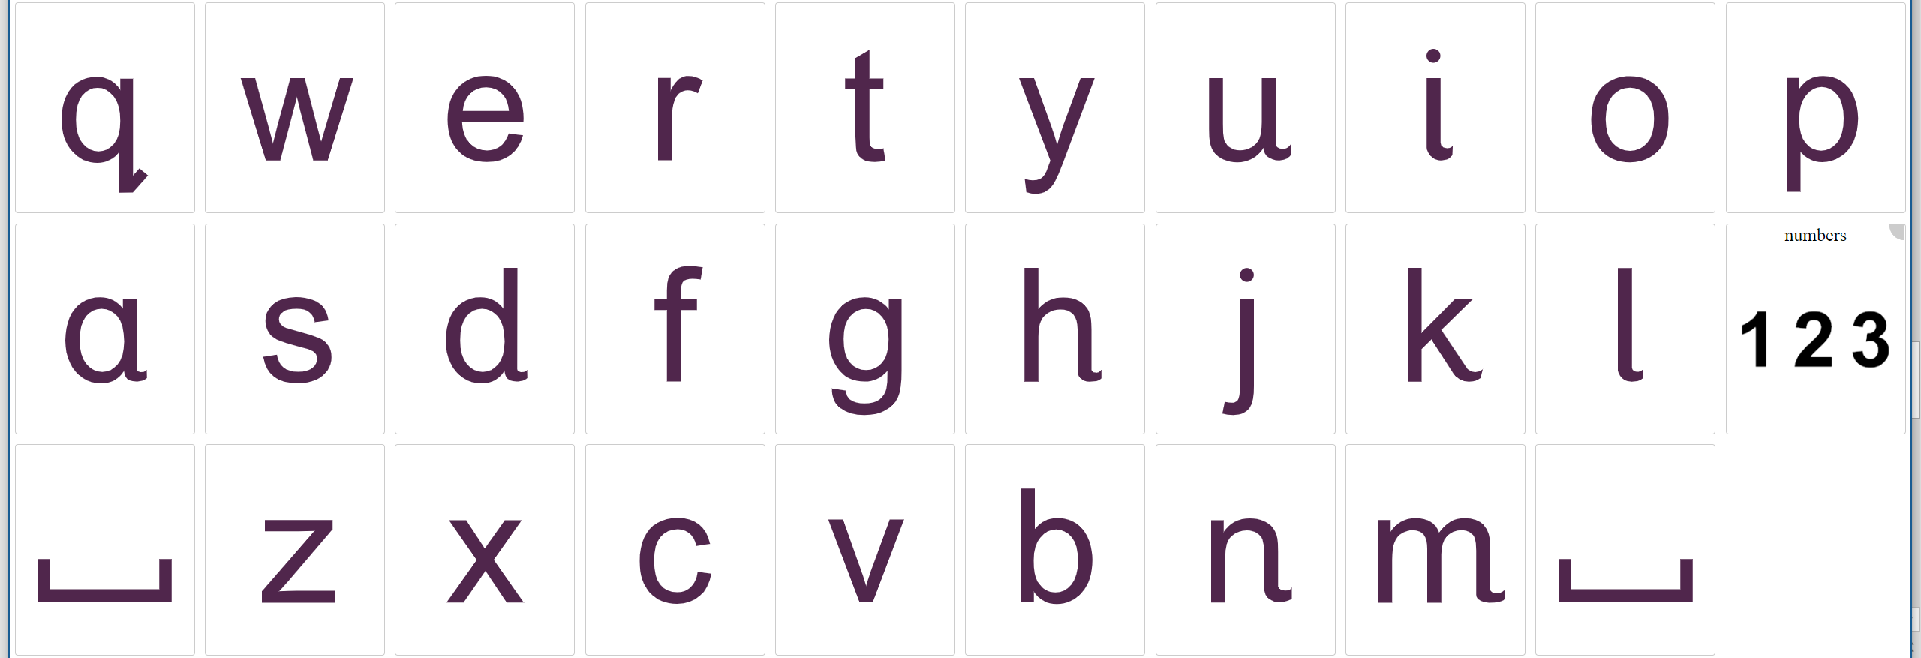
Making an alphabet and numbers chart
Download and configure the keyboard
Connect to PC

Slide 7
Summary
Extending vocabularies and board building
Creating communication books from online boards
Uploading other boards – obf and obz

