Slide 1
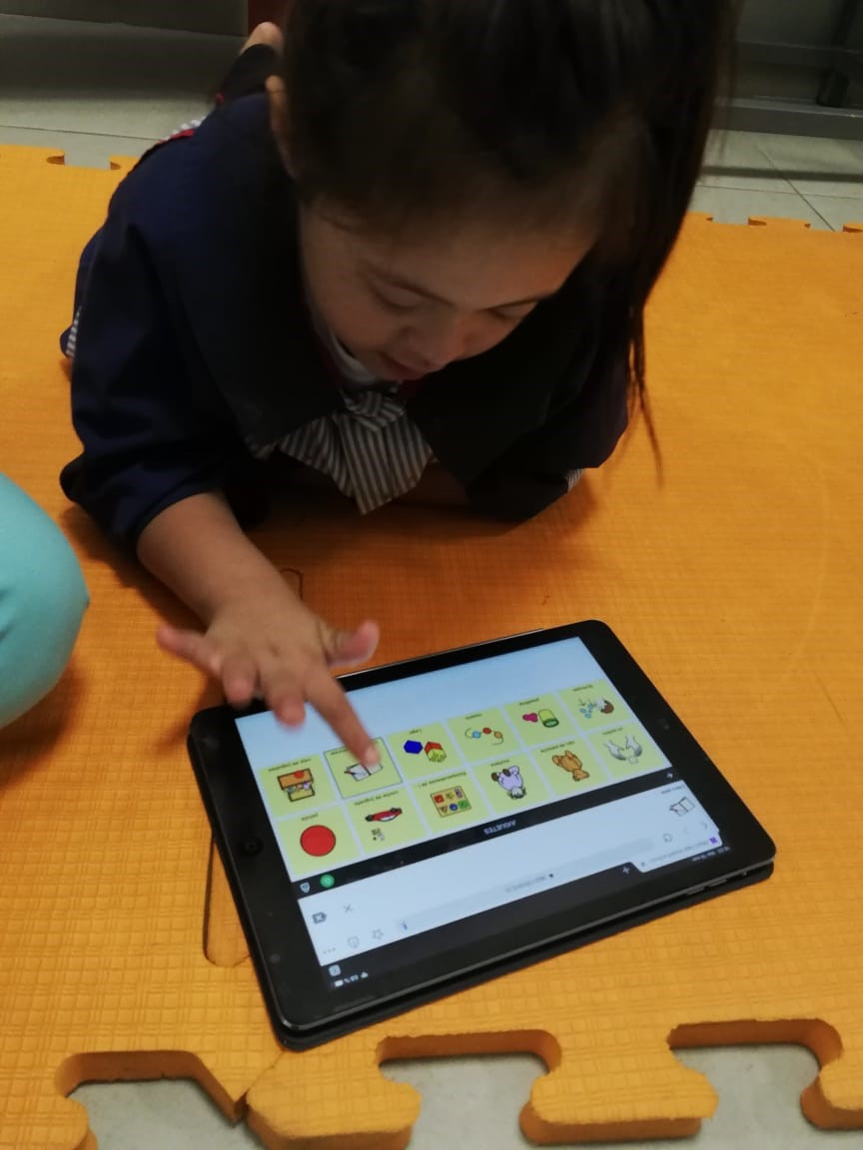
Building Boards 2
E.A. Draffan

Slide 2
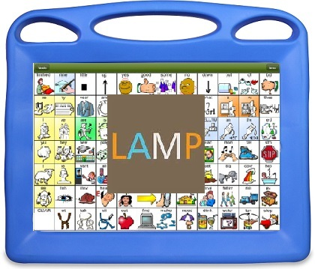
Building Boards
Milo Age 3 – Building for phrases and extended vocabulary – making folders
https://bit.ly/2pSSmxW
Using LAMP as a system

Slide 3
Language Acquisition through Motor Planning (LAMP)
Readiness to Learn – Potential user has the ability
Joint Engagement – communication partners
Consistent and Unique Motor Patterns – develop automaticity
Single Words – words to make up sentences rather than being give completed phrases
Auditory Signals – symbol choice is spoken
Natural Consequences – linked outcome as a result of choosing a symbol – apple – they see/eat the apple

Slide 4
Principles of Word for Life app (LAMP)
A word-based program. A priority is placed on core vocabulary with access to fringe.
One motor plan per word allows for the development of quick effortless communication. No repeating words based on category; homonyms not present until the full level.
No motor plan changes as language develops. Motor plans can grow but not change.
At the LAMP 84 full level, EVERY word can be accessed in 3 hits or less.
At the full level, the initial core word appears as a label on the first button.
No carrier phrases – You do not have to hear a word to get a word
First 4-5 spaces on the second row are empty in the transition and full levels. Storing personalized words here allows for the motor plan for these words to remain constant across levels.
No triple hits on one icon. No double hits on an icon before going to a third icon.
https://aacapps.com/pdf/LAMP-WFL-for-iPad-Quick-Reference.pdf

Slide 5
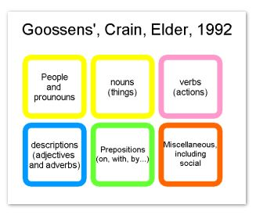
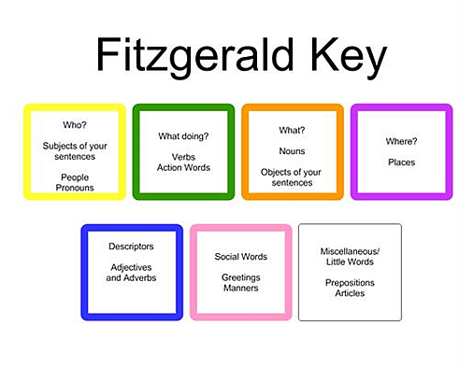
Home board 6x6
I | is | help | not | why | chat
you | can | like | more | what | about me
he | do | go | this | where | time/place
she | have | stop | that | on | food/drink
it | want | play | now | good | things/topics
yes | people | actions | little words | ? / describe | no
Folders – categories
Colour codes – make sure you are consistent

Slide 6
Building a board with categories

Slide 7
Core chart - Cboard Instructions
Make a series of empty cells / tiles 6x6
Turn as many as you want into folders along the bottom –
Go to each tile – select folder – add symbol, label and colour
Save and then when on the home board select that folder and you will go to an empty board.
Add tiles

Slide 8
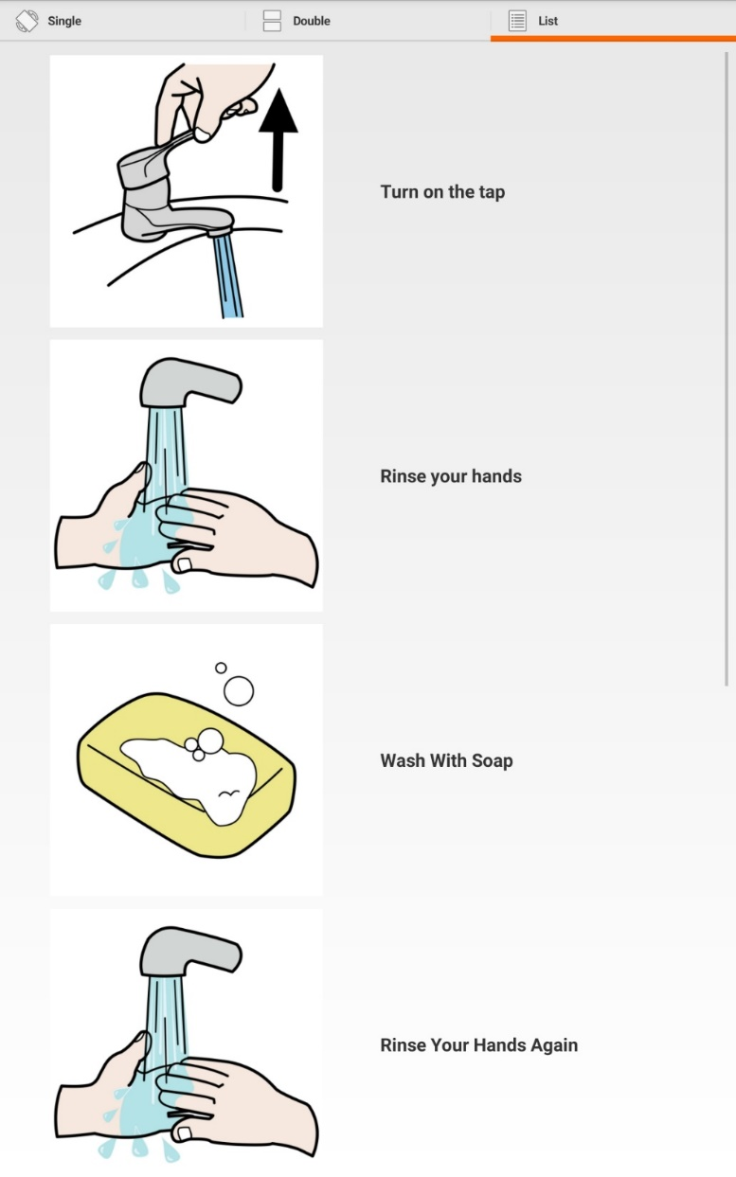
Visual Schedule
Case Study Petra 6 years old
https://bit.ly/2N98gwi
Try this sample Visual Schedule on your tablet
Google Play – Search “What's Next Lite” https://bit.ly/2PnzfqN
Quick start instructions http://www.lifeaxis.ca/quick-start

Slide 9
Summary
We discussed
Multisensory approach
Automaticity
Position
Recognition
Colour
Parts of speech – language building – sentence construction
Text to speech

