Slide 1
Building Boards 1
E.A. Draffan

Slide 2
Building Boards
Building boards with Cboard
Fiona Age 2 – Earliest type of board for gaining attention, interaction and early requesting
Yola Age 6 – Core board building – 2 word phrases
https://bit.ly/2N98gwi

Slide 3
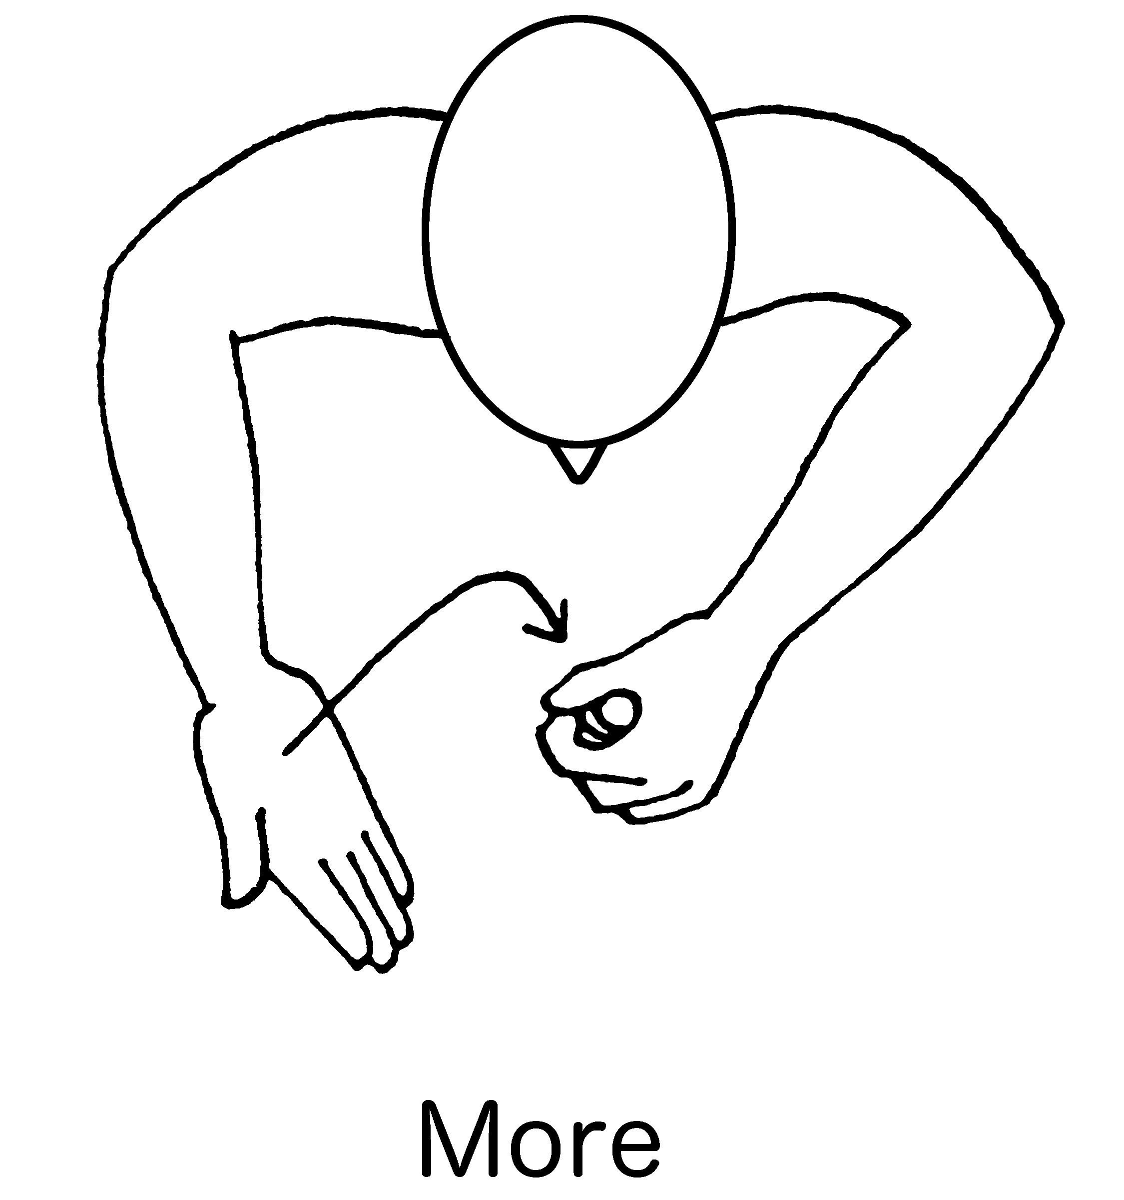
Make your first board
Fiona Age 2 – Earliest type of board for gaining attention, interaction and early requesting
Yes/no
More /stop
(Makaton)

Slide 4
Initial Cboard Instructions
Install – Login using Portrait mode
Select the padlock – top right – three taps to unlock – Go to Landscape mode
Select Edit – left on blue band, select little blocks and then the + sign on the right
Allow Cboard access to photos etc
Select empty board – select magnifier top right – type in label ‘more’ – select symbol
Change label if needed, add colour and save
Add more tiles in a similar way

Slide 5
How the board can be used
Steps | Technique | Examples
Prompt | Physical cue | Move a hand to indicate what is wanted - points
 | Verbal cue | “let’s play with the rattle”
 | Gestural cue | Makes a gesture of shaking the rattle
 | Pause | Wait for child’s reaction – eye contact, sound, gesture
Model | Gesture model | Points to picture/symbol ‘more’
 | Verbal model | Word is spoken/text to speech ‘more’
Outcome | Object/Activity provided | Child reacts positively, points, touches board or toy etc
 | Imitation | Copy child’s reaction and provide positive feedback
 | Recast – repeat any error in a corrected and positive way. | Say the word again ‘more’ and point to the board with praise

Slide 6
Find a Motivating Activity to gain Attention
Choose an activity that allows you to start with a single word
Make sure you have time and are relaxed with the child
Have toys or action ready so you have the child’s attention
Choose a word such as ‘play’ ‘go’, ‘on’, ‘eat’, ‘more’ etc and start modelling (pointing to the word) as you do the action
Repeat … repeat and see reaction – if positive repeat with action …
Pause – wait for the child to interact, look and touch the board or indicate understanding – praise – build slowly. Short sessions
Use the word later with another activity

Slide 7
Cause and Effect
Example Frankie’s Baby Fireworks
https://bit.ly/2pe7Rk3

Slide 8
Create your own 2 word chart
I |  | help
you |  | like | more
yes | play | go | stop |  | no
This is a view using a 6x6 grid that eventually allows for a core vocabulary with symbol positions being set at the beginning.
These initial symbols can be viewed without scrolling. It is easier to add more symbols to empty tiles once you have a layout in place.

Slide 9
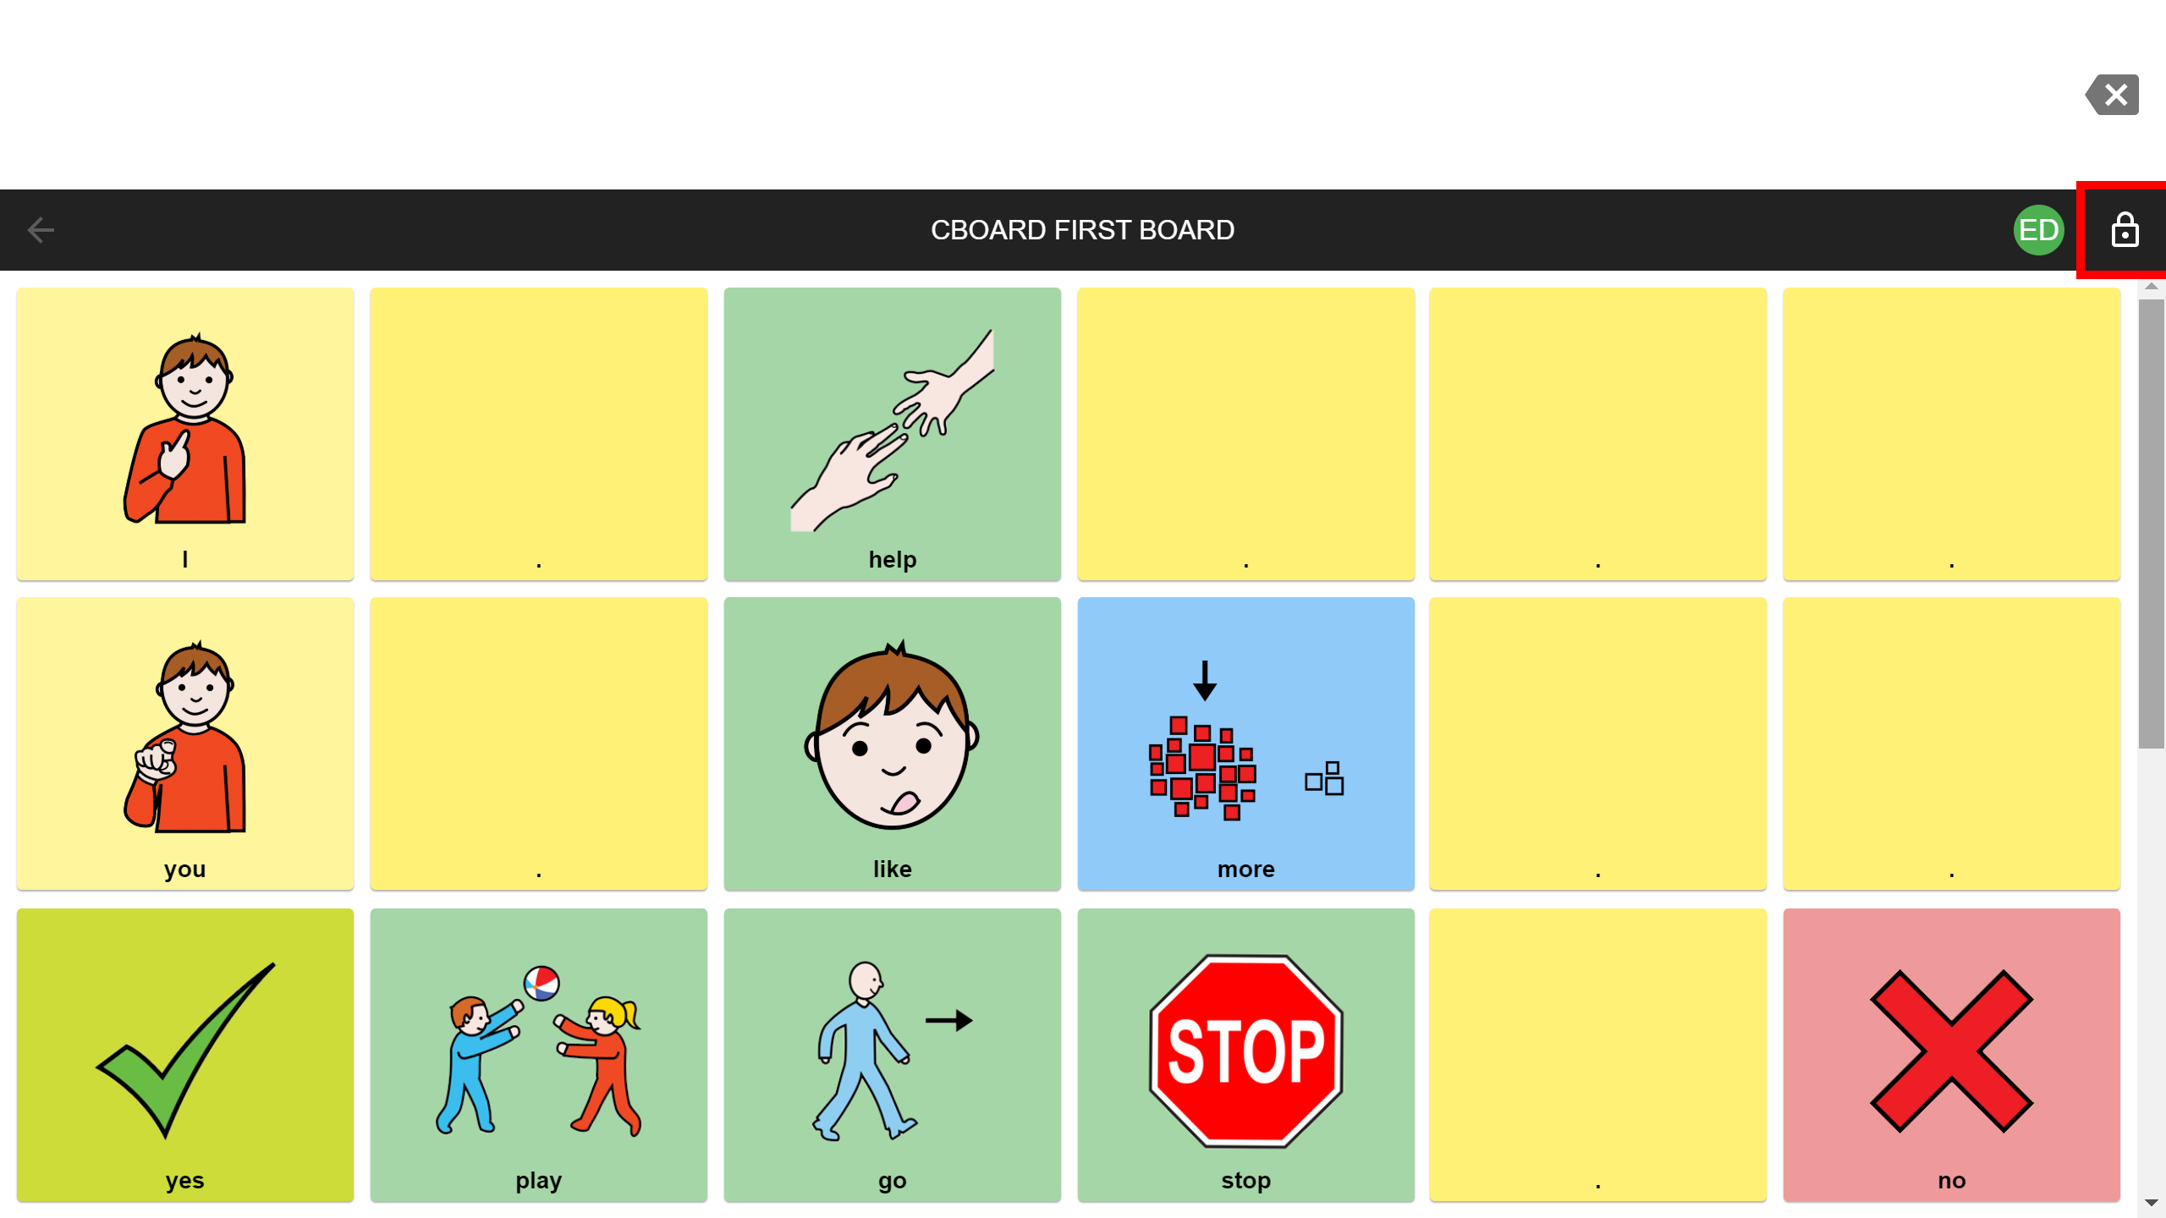
Build your next board
Example of a board where there are many empty cells / tiles, but the position of the keywords / symbols begin to be learnt.
Yola Age 6 – Core board building – 2 word phrases
https://bit.ly/2N98gwi

Slide 10
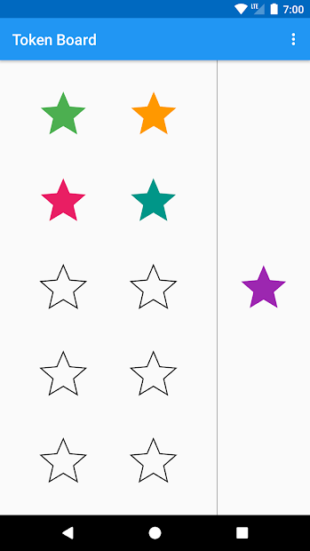
Gaining Attention
Minimize distractors for better attention – keep the activity short – age+1 – 3 years old may only last 4 mins!
Use a Token board for praise and try to achieve success early on!
Google Play – Search “Token Board” https://bit.ly/32zYYzU

Slide 11
Summary
High tech and low tech communication activities need to have meaning – relate any interactions to achievable goals
Praise and Progress
Provide multiple engaging ways of learning the same vocabulary
https://www.youtube.com/watch?v=pZw9veQ76fo

