Slide 1
Learning Review

Slide 2
Reviewing the course
In this session we will present some examples of AAC users
We will ask you to read the background information
Make notes on the key issues that you will need to consider in making a recommendation
Suggest some of the key features that would be included in your recommendation for this child
All of the case studies are based on those developed by the Communciation Trust in the UK

Slide 3
Edie
Edie has the spastic quadriplegic form of cerebral palsy.
The term spastic refers to tightening and stiffening of the muscles and quadriplegic means that it affects all four limbs.
This affects her ability to control the movement of her arms and legs, and her ability to speak.
Edie did not attend a preschool setting in the early stages of the project, but has more recently started attending a nursery within a special school.
Edie’s disability has meant that it is difficult for her to play with toys independently and to speak.
It has been important to find ways that she can have some independent control and maintain her active engagement with activities.
Similarly it has been important to develop ways for her to communicate other than by speech.

Slide 4
Edie
Access and Control
Despite finding it difficult to manipulate toys using her hands and feet, Edie is very good at looking and using her eyes to ‘talk’.
This is easy for Edie to do and can be developed as a way for her to control other people to do the things that she finds difficult.
Using her eyes to communicate, Edie can still make things happen, she is simply getting you to do it for her.

Slide 5
What are the options for Edie
Draw up a list of questions that you want to ask to help you decide on an AAC solution for Edie
What do you need to know?
What assumptions can you make so far?
What solutions would you want to test and consider at this early stage?

Slide 6
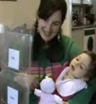
Eye Pointing
From a very young age Edie’s mum has interpreted Edie’s communication by following where she is looking. This works well if what Edie wants to say is visible, but sometimes she needs to be able to communicate more than that.
Edie and her parents were shown an E-Tran frame and ways to use it. This would enable Edie to begin to express her own choices, wants and needs.
Edie is looking at the photographs, learning to look longer at the photograph of the toy she wants to play with. Sometimes
Edie will look at her choice and then make eye contact with you so that you know which she wants.

Slide 7
Did you consider Eye pointing as an option?
Edie is learning to recognise different symbols so that she can use eye pointing to communicate in lots of different ways. She has learnt the symbols for ‘more’ and ‘stop’, so that she can tell her mum if she wants more of an activity or to stop. Edie can look to these symbols when playing bubbles, having tickles, singing songs, reading books or playing with her toys.
If Edie can use eye pointing well, she may be able to use eye gaze technology in the future. For now it is important that she practises the necessary skills and also has some immediate success with what she is doing.

Slide 8
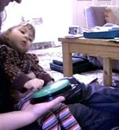
Switch Access
Edie can use her eye pointing skills to direct someone else to manipulate her toys, but sometimes it is fun to do it herself.
For this reason Edie has tried to use a switch to operate toys and activities.
Edie is using her hand to operate a switch. She has used the switch to control toys and to operate the computer.
She has been trying to find the easiest way to operate her switch, so that it can be used for lots of different activities.

Slide 9
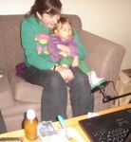
Thinking about positioning
It isn’t easy for Edie to activate the switch with her hand, so she has also tried using her feet.
Edie is using the switch to look at some photographs on the computer. Each time she presses the switch, she can see another family photograph.
Edie really likes to look at the photos of her Daddy when he is out at work.

Slide 10
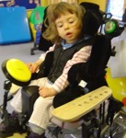
Movements
Edie’s range of movement can be very different depending on how and where she is positioned so it has been important to consider her control of switches in different positions and environments.
Edie is practising using a switch. She needs lots of practise to work out if the switch is in the best position for her. The switch press needs to be easy to do and repeat

Slide 11
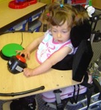
Switches offer options
With the tray on her chair, it is easier to see the switch to operate it with her hand than with her foot
Switches can be used to control many different things as well as toys and computers.
Switches can operate Voice Output Communication Aids (VOCAs) and powered wheelchairs as well as control domestic appliances such as televisions and lights and mechanisms such as door openers and electronic curtain rails, all of which allow greater independence.
It is necessary to have lots of practise using switches in a fun and error-free way first, before beginning to use them for functional applications.

Slide 12
Switch Skills
Initially Edie needed to learn that pressing a switch results in something happening.
This is sometimes called ‘cause and effect’. Edie quickly learned that she could operate toys and the computer by pressing a switch.
Edie needs to be able to press the switch accurately and with ease and does not want to press it by mistake. In order to practise this skill she has explored some ‘build’ activities. This means that she has to press the switch several times to achieve the end result, for example Edie may press the switch to reveal sections of a picture.
Once the picture is complete it will play an animation and a song. Examples of these activities are available in the Useful Links section.
Edie has also used switches to operate battery powered toys and mains operated activities such as fans and bubble machines.
The fan is plugged in to a PowerLink. This allows a switch to be connected to turn on the fan.

Slide 13
Scanning
Edie is continuing to practise her scanning skills using the computer. In the future, she may use these skills to operate a voice output communication aid as well.

Slide 14
Communication
Edie has practised using her eyes to communicate. She has been learning that others can understand her by following her eyes to see what she is looking at. Edie has had to learn to recognise photographs and symbols and apply a meaning to eye pointing to them. So, for example, she knows that if she eye points to a photo of Dad and a photo of a cup, this means she is asking Dad to give her a drink.

Slide 15
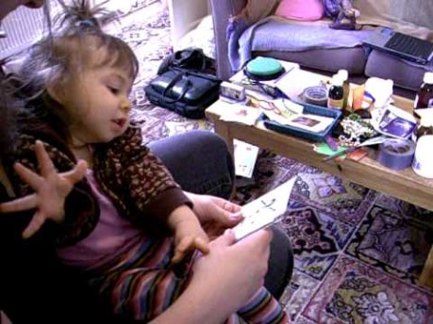
Edie Communicating
Edie’s Mum is showing her symbols to choose from. She is showing Edie the choices and reading them to her; Edie will indicate her choice when she gets to the one that she wants. Edie is learning to say ‘Yes’; in this video she nods her head.

Slide 16
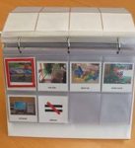
Listener Mediated Scanning
Edie is being introduced to Listener Mediated Scanning. Edie is given a series of choices and will indicate when offered the choice that she wants.
This is similar to scanning with a switch. It is helpful to practise this principle before using a switch for scanning.
The choices are offered to Edie in the same order. This means that she can learn the order and anticipate the options. It also ensures that she has the same choices, even if different people are offering them and she can always get to the message that she wants.
This is a page in Edie’s Listener Mediated Scanning communication book. There are photographs of the activities in the Nursery.
Her teacher can go through the choices and Edie will indicate ‘yes’ when she gets to the one that she wants to do.

Slide 17
Saying Yes
Edie has used several ways to indicate ‘yes’; she will nod, vocalise or use facial expression. But having many different ways can be difficult for other people to interpret. Now Edie is being encouraged to eye point to a symbol for ‘yes’ to ensure that she is correctly understood.
Edie is continuing to practise and develop her eye pointing and switch access skills. She is growing and changing and new technologies continue to emerge, so it is important that these methods continue to be reviewed.
Currently she is achieving greatest success controlling a switch with her foot. Her parents and the team around her continue to monitor and evaluate this.

Slide 18
Lessons learned
Make a note of any thing important that you learned from this case study
Review your notes and explore our further reading materials to think about the issues in greater depth

