Slide 1
Pre-Communication Skills
E.A. Draffan

Slide 2
Pre-linguistic Communication
Pre-linguistic stage approx. 0 > 6 months - crying, whimpering, cooing - involuntary responses to stimuli.
But … first language acquisition begins at or before birth,
However…linguists consider human language to be creative i.e. free from internal or external stimuli

Slide 3
Learning the Sounds of a Language
“Sensory and brain mechanisms for hearing are developed at 30 weeks of gestational age.”
A 2013 study “shows that unborn babies are listening to their mothers talk during the last 10 weeks of pregnancy and at birth can demonstrate what they’ve heard.”
“Babies only hours old are able to differentiate between sounds from their native language and a foreign language”
https://www.washington.edu/news/2013/01/02/while-in-womb-babies-begin-learning-language-from-their-mothers/

Slide 4
Sounds of Language
https://youtu.be/NelkdahgyWE

Slide 5
Pre-Communicative Behaviours to Formal Communication Skills
Take the cards and place in order of communication development on the progression chart
Some may overlap
Adapted from PVCS
Pre-Communication
Informal Communication
Formal Communication
Use of visual cues

Slide 6
Consider Fiona’s communication behaviour
Fiona Age 2 https://training.globalsymbols.com/course/view.php?id=56#section-4
Pre- communication
Possible informal communication
Next stage to formal communication
Record any strengths you notice from the profile
Highlight the child’s speech, language and communication needs
Describe how these needs may affect the child’s development now and in the future

Slide 7
Pre-Communication - Behaviours
Use of visual cues
Hearing and listening
Development of vocalisations
Control of speech musculature
Consistent use of noises
Towards informal communication
Motor imitation (Overlap)
Vocal imitation (Overlap)

Slide 8
Ideas to gain attention
Goal is to engage the child with his/her world
Use familiar routines, find child’s interests and follow the child’s lead
Try objects with interesting sounds, lights, or textures to grab and hold the child’s attention
Model the purpose of the item/toy, as the child may not know how to interact with it (may have to be hand over hand initially)
Be face to face, use physical proximity, exaggerated gestures/tone of voice/exclamations/facial expression, use touch, physically get into child’s line of vision
Progress to sharing a common focus by shifting their attention between each other and an object/activity Includes: gaining, directing, shifting, and maintaining attention
Directed through eye gaze or gesture (e.g., point)

Slide 9
Informal Communicative Behaviours
Needs Satisfaction
Shared Attention
Attention Seeking
Simple Negation

Slide 10
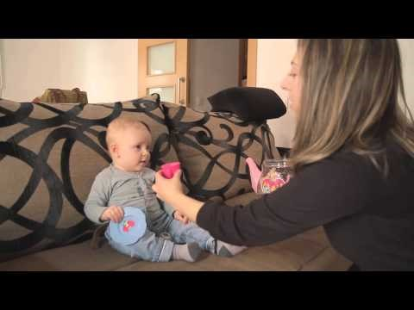
Intentionality
https://youtu.be/eyKhzuI8q3E

Slide 11
From Pre-linguistic to Intentional Communication
Use cause-and-effect activities with actions/objects to bridge the development of intentional communication
Treat what the child does as a message rather than a behaviour (e.g., if child pushes a toy away, label for him “all done”)
Set up opportunities/reasons for the child to communicate (i.e. “communication temptations”)
Consider which of the 5 senses is most motivating to the next child and try to think of other activities that could support communication.

Slide 12
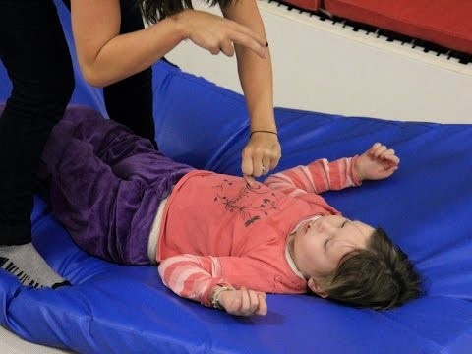
Motivation through intentional movement
https://youtu.be/Jb5DtDo-VAQ

Slide 13
Formal Communication Skills
Understanding of non-vocal communication
Understanding of vocalisation and speech
Use of symbols, signs or speech

Slide 14
Using a score sheet evaluate skills and plan for progression
The columns are for checks over time
Simple scoring: Red (never observed), Yellow (intermittently), Green (consistently) in the first column.
Comments in the observation box
For this activity we return to the case study we watched last time we were together.
Adapted from PVCS

Slide 15
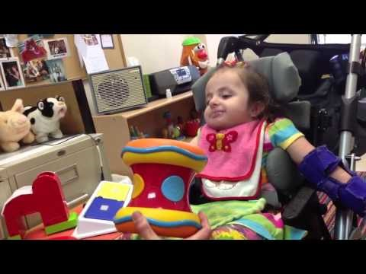
Rebekah age 4 years
https://youtu.be/lHZBpvBTb10

Slide 16
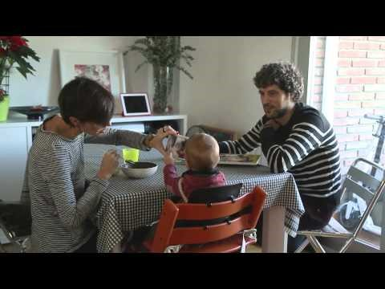
First Words on the Communication Journey
https://youtu.be/KmrgkfqhWDc

