Slide 1
house kuća
Scale of 1-5 where 1 = Completely unacceptable and 5 = Completely acceptable
1 | 2 | 3 | 4 | 5
feelings about the symbol as a whole
represents the word or phrase
colour contrast
cultural sensitivity
Comment

Slide 2
house kuća
Scale of 1-5 where 1 = Completely unacceptable and 5 = Completely acceptable
1 | 2 | 3 | 4 | 5
feelings about the symbol as a whole
represents the word or phrase
colour contrast
cultural sensitivity
Comment

Slide 3
yes da
Scale of 1-5 where 1 = Completely unacceptable and 5 = Completely acceptable
1 | 2 | 3 | 4 | 5
feelings about the symbol as a whole
represents the word or phrase
colour contrast
cultural sensitivity
Comment

Slide 4
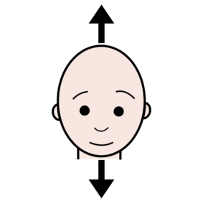
yes da
Scale of 1-5 where 1 = Completely unacceptable and 5 = Completely acceptable
1 | 2 | 3 | 4 | 5
feelings about the symbol as a whole
represents the word or phrase
colour contrast
cultural sensitivity
Comment

Slide 5
before prije
Scale of 1-5 where 1 = Completely unacceptable and 5 = Completely acceptable
1 | 2 | 3 | 4 | 5
feelings about the symbol as a whole
represents the word or phrase
colour contrast
cultural sensitivity
Comment

Slide 6
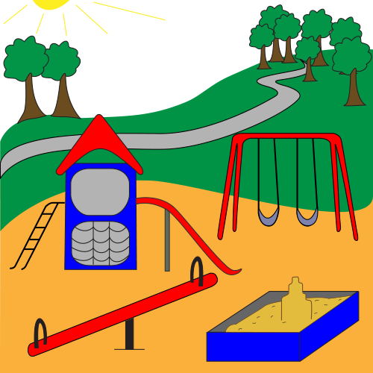
park park
Scale of 1-5 where 1 = Completely unacceptable and 5 = Completely acceptable
1 | 2 | 3 | 4 | 5
feelings about the symbol as a whole
represents the word or phrase
colour contrast
cultural sensitivity
Comment

Slide 7
park park
Scale of 1-5 where 1 = Completely unacceptable and 5 = Completely acceptable
1 | 2 | 3 | 4 | 5
feelings about the symbol as a whole
represents the word or phrase
colour contrast
cultural sensitivity
Comment

Slide 8
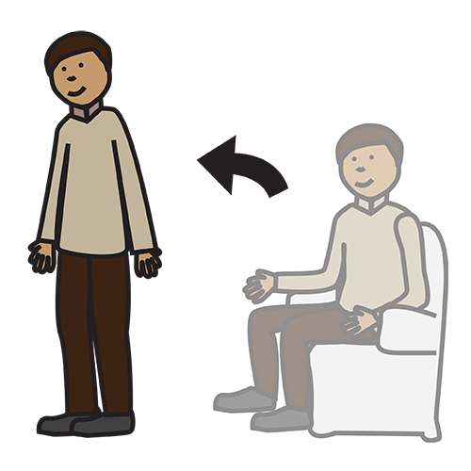
stand stajati
Scale of 1-5 where 1 = Completely unacceptable and 5 = Completely acceptable
1 | 2 | 3 | 4 | 5
feelings about the symbol as a whole
represents the word or phrase
colour contrast
cultural sensitivity
Comment

Slide 9
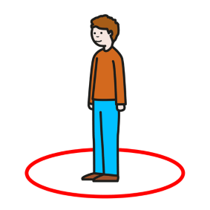
to stand stajati
Scale of 1-5 where 1 = Completely unacceptable and 5 = Completely acceptable
1 | 2 | 3 | 4 | 5
feelings about the symbol as a whole
represents the word or phrase
colour contrast
cultural sensitivity
Comment

Slide 10
and i
Scale of 1-5 where 1 = Completely unacceptable and 5 = Completely acceptable
1 | 2 | 3 | 4 | 5
feelings about the symbol as a whole
represents the word or phrase
colour contrast
cultural sensitivity
Comment

