Slide 1
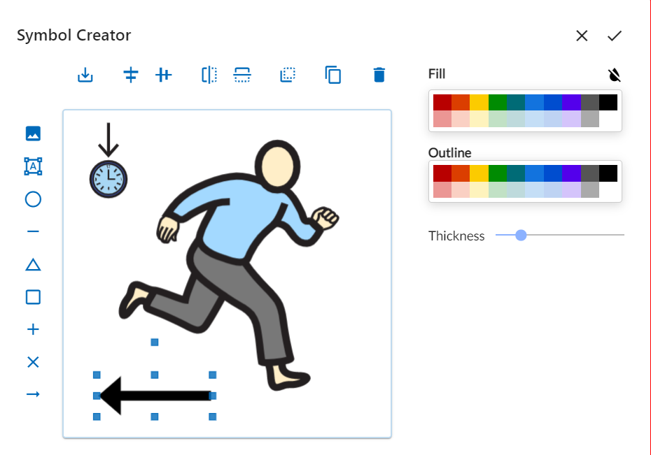
Symbol Creator Introduction
https://globalsymbols.com/

Slide 2
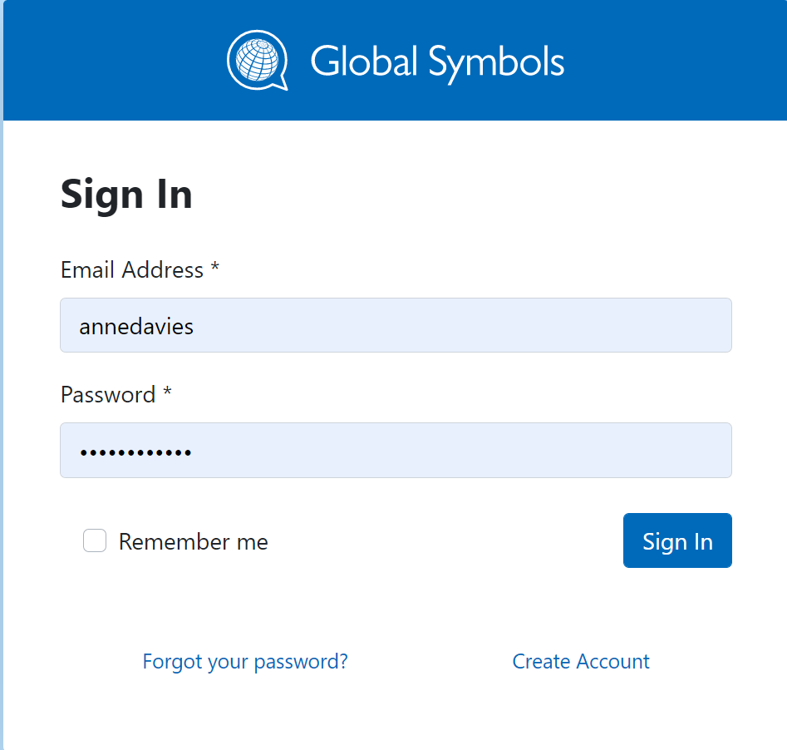
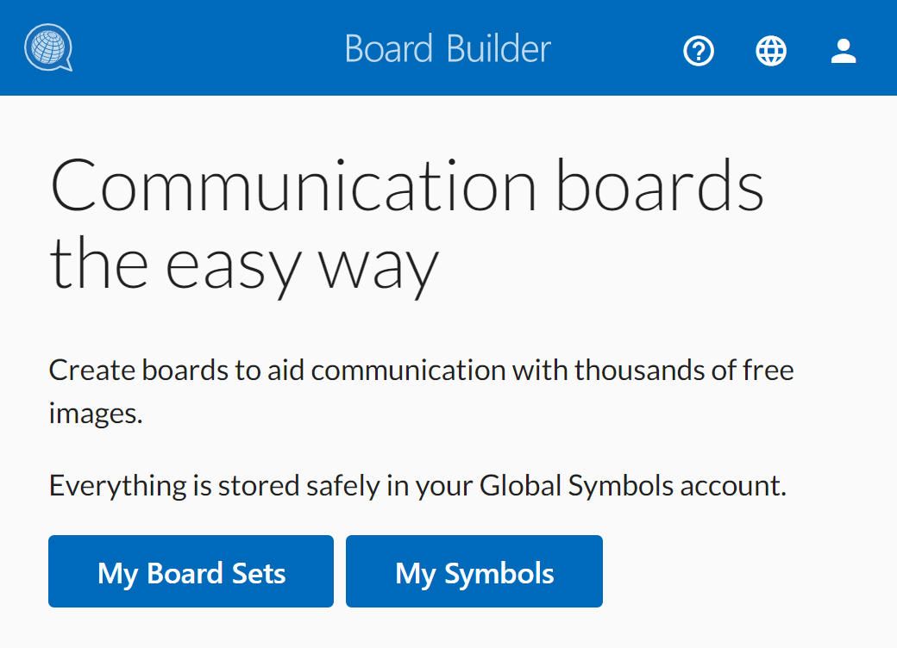
Symbol Creator as part of Global Symbols and Board Builder
Log into Global Symbols https://globalsymbols.com/ or create an account and select the language of your choice then go to the main menu to select Board Builder
Or go to ‘My Board Sets’ if you have an account.

Slide 3
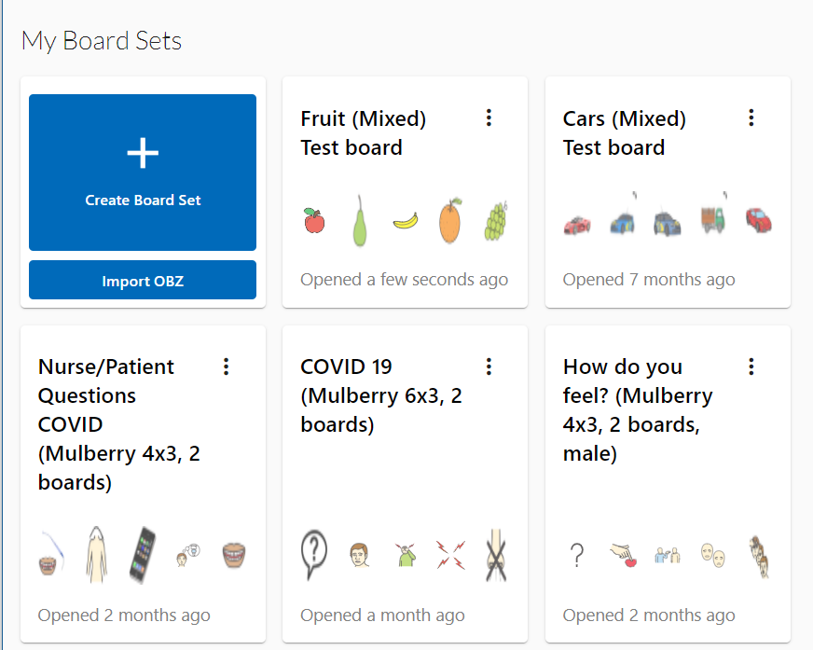
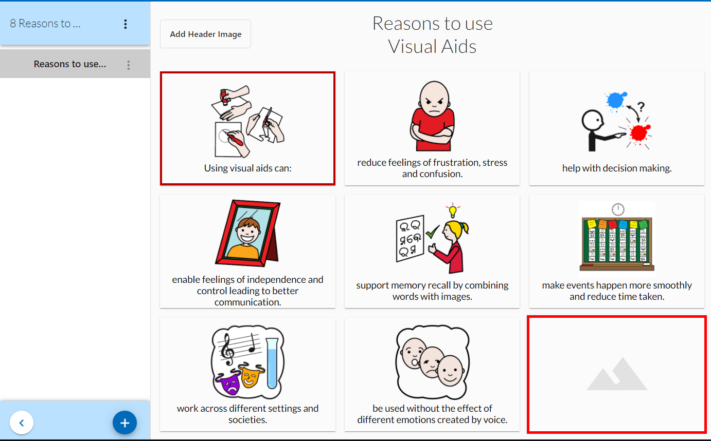
Selecting a Board Set and empty cell to make use of Symbol Creator
Create a new Board Set or choose one you have started
Go to an empty cell to make your own symbol or image rather than using one available in Global Symbols or the other repositories available, such as Open Symbols or the Noun Project.

Slide 4
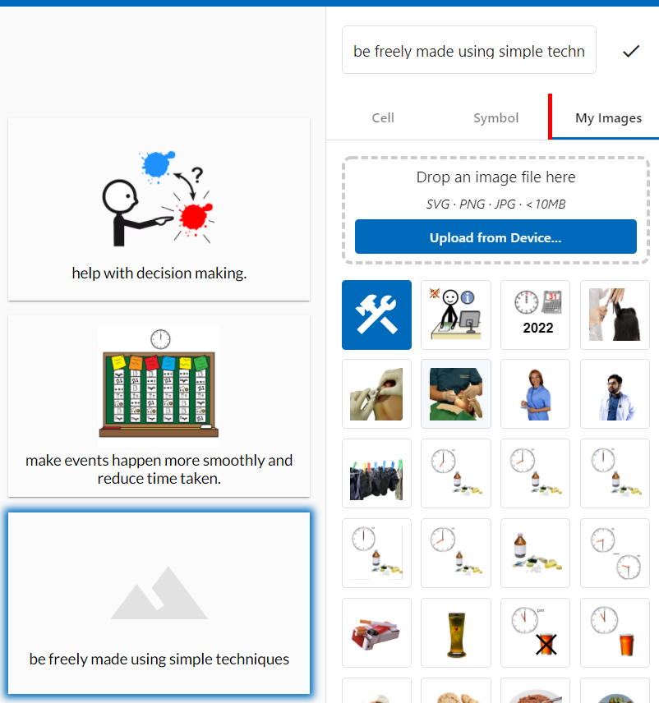
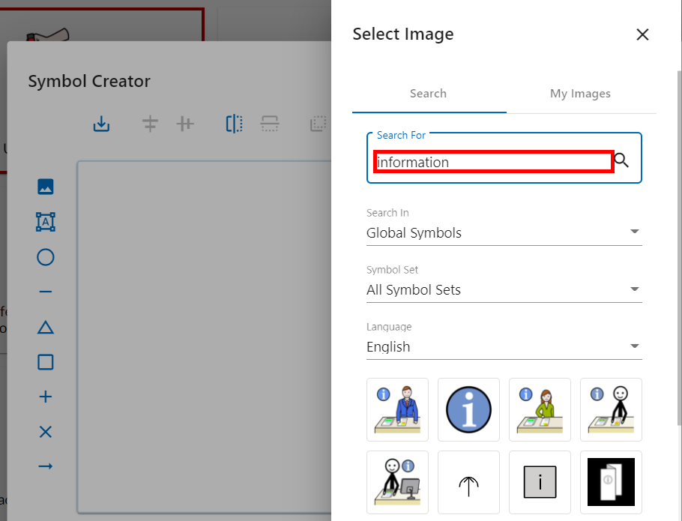
Making your own Symbol or Image for a Board.
Add a label to the cell
Go to ‘My Images’
Select Symbol Creator (hammer and spanner image)
Add a symbol by using the image icon at the top of the left hand menu bar
Each icon will have a tool tip telling you what it does
1
2
3
4

Slide 5
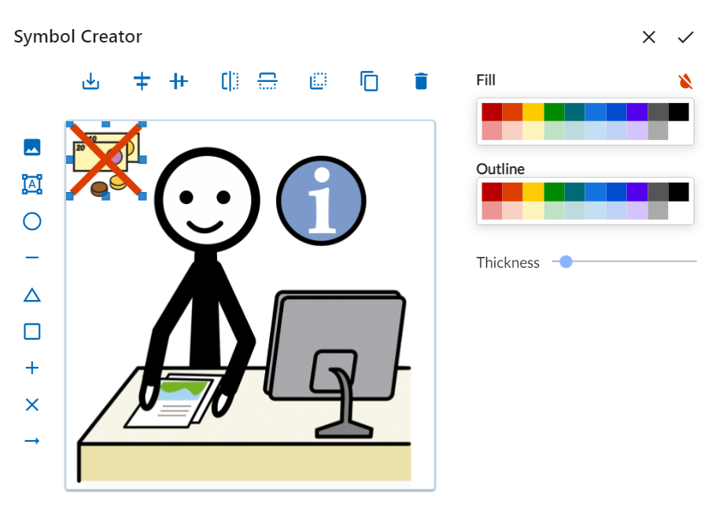
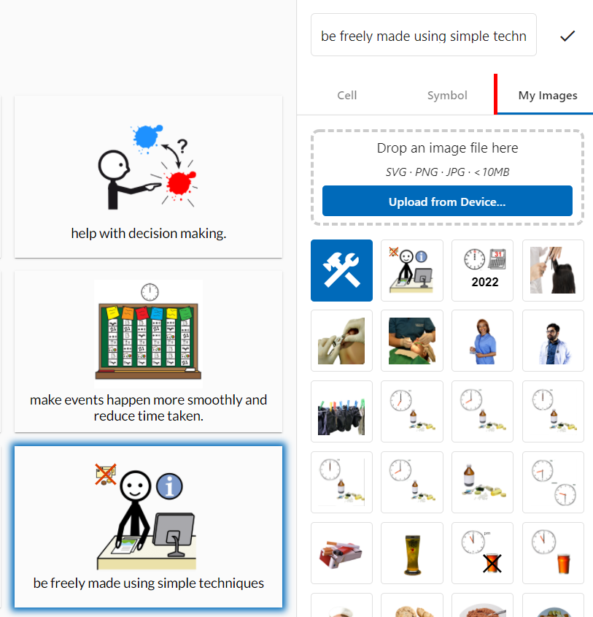
Adapt your symbol to suit your needs
Having added a symbol, position and resize it to fill the 500 x 500 pixel square
Add another image, text or shape to adapt the symbol to suit the concept you want to create
All items can be flipped and resized, shapes and lines can be recoloured
Select the tick to add it to your board.
New symbols are automatically saved to ‘My Images’ – your own online symbol repository.
3
4
1
2
5

Slide 6
Any Questions?
Send us an email hello@globalsymbols.com or
Join us on https://www.facebook.com/globalsymbols
Symbols thanks to ARASAAC, Mulberry and Sclera

